Slide 1

Fractal Set Generators in C
Exploring the infinite complexity of the Mandelbrot, Julia, and Tricorn sets through escape-time algorithms

Slide 2

The Allure of Fractals
What Makes Fractals Special?
Fractals reveal infinite detail at every scale, exhibiting self-similarity—patterns that repeat endlessly as you zoom in. This mathematical beauty emerges from remarkably simple iterative rules.
Our objective: Implement efficient C programs to render three classic fractal sets using escape-time algorithms, transforming complex mathematical iteration into stunning visual representations.

Slide 3


Mathematical Foundation: The Mandelbrot Set
The Iteration Rule
At each point c in the complex plane, we iterate:
Starting condition: z_0 = 0
The Escape Criterion
A point belongs to the Mandelbrot set if its orbit remains bounded—meaning |z_n| never exceeds 2, no matter how many iterations we perform.
Points that escape yield beautiful boundary patterns.

Slide 4



Julia and Tricorn: Fascinating Variants
Julia Sets
The Tricorn (Mandelbar)
The Julia set uses the same quadratic iteration but with a crucial difference:
This variant introduces the complex conjugate, creating unique symmetry:
Here, c is a fixed complex constant whilst z_0 equals the pixel coordinate. Different values of c produce dramatically different fractal shapes—from connected dragons to scattered dust.
The conjugate operation reflects points across the real axis, generating distinctive heart-shaped features and altered self-similarity patterns.
Escape condition: For all three sets, we test whether |z| > 2. If this occurs before MAX_ITER iterations, the point escapes. Otherwise, it belongs to the set's interior (typically rendered black).

Slide 5

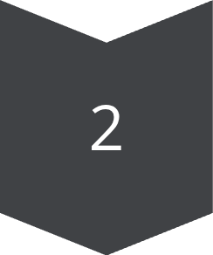



Algorithm Overview
Initialisation
Read parameters: image dimensions (W×H), complex plane bounds, MAX_ITER, fractal type, and Julia constant c if needed.
Pixel Mapping
For each pixel (x,y), map screen coordinates to a complex number in the viewing window.
Set-Specific Setup
Mandelbrot: z_0 = 0, c = pixel coordinate
Julia: z_0 = pixel, c = fixed constant
Tricorn: Use conjugate in iteration step
Iteration Loop
Iterate the formula. If |z| > 2, colour the pixel based on escape iteration count. If n reaches MAX_ITER, render as interior (black).
Output
Write the complete image to file and finish.

Slide 6

Implementation in C
Technical Stack
Language: C99 standard
Key headers: stdio.h, complex.h
Output format: PPM (Portable PixMap) text mode P3
Build command:
gcc -o mandelbrot mandelbrot.c -lmgcc -o julia julia.c -lmgcc -o tricorn tricorn.c -lm
Each generator follows the same structure with set-specific iteration logic encapsulated in separate source files.

Slide 7
Core Code: The Escape-Time Loop
for (int n = 0; n < MAX_ITER; n++) { if (cabs(z) > 2.0) { // Escaped: map n to colour color = palette[n % PALETTE_SIZE]; break; } z = z*z + c; // Mandelbrot iteration}if (n == MAX_ITER) color = BLACK; // Interiorwrite_pixel(x, y, color);
This compact loop embodies the escape-time algorithm: iterate the fractal formula, test the magnitude, and colour accordingly. The iteration count determines the hue, creating the characteristic banding patterns around the set boundary.

Slide 8

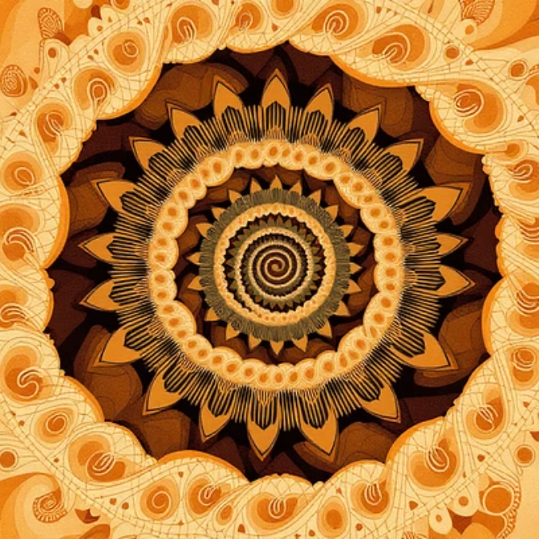
Results: Mandelbrot Set Renders
Default View
Zoomed Detail
Resolution: 1920×1080
Resolution: 1920×1080
MAX_ITER: 256
MAX_ITER: 1024
Bounds: Re[−2.5, 1.0], Im[−1.2, 1.2]
Bounds: Re[−0.8, −0.4], Im[0.0, 0.4]
The left image shows the iconic Mandelbrot "bug" shape with its main cardioid and circular bulb. The zoomed view (right) reveals intricate self-similar miniature copies and delicate filaments requiring higher iteration counts.

Slide 9

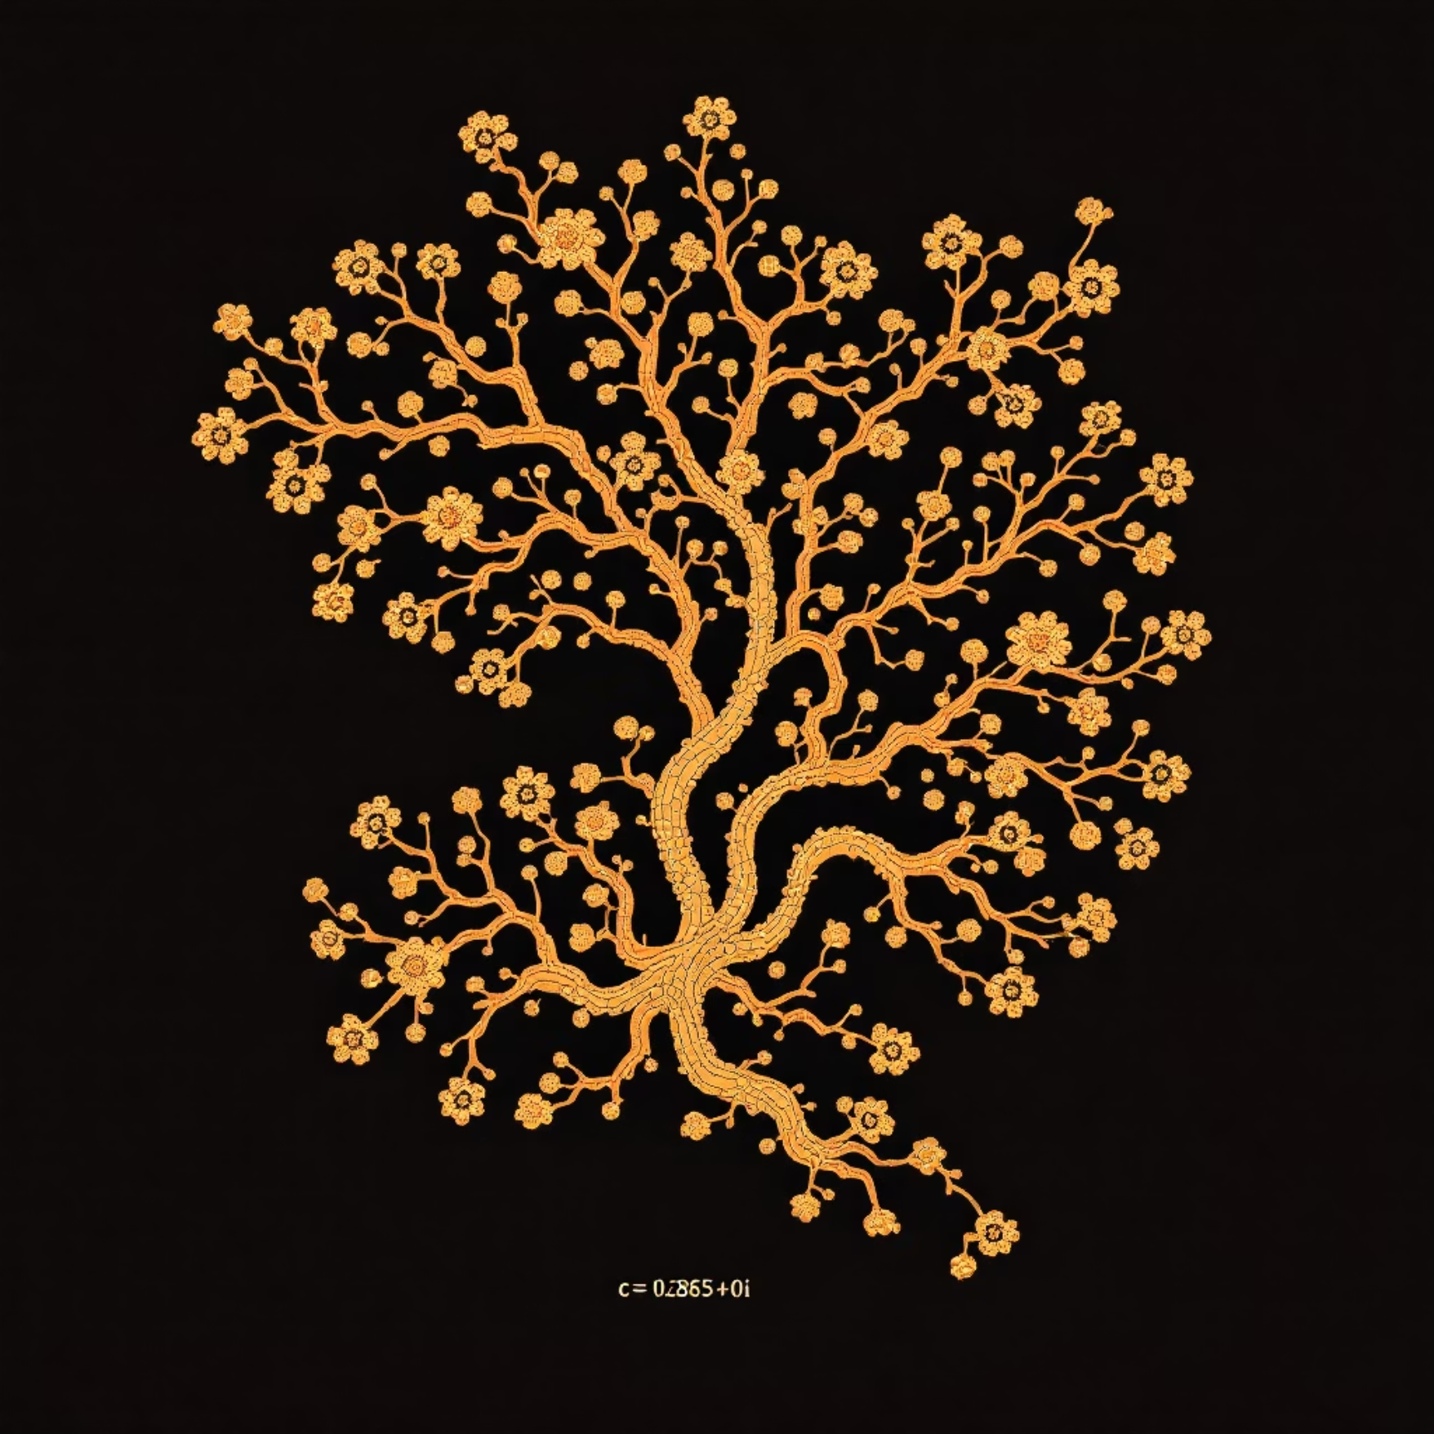
Results: Julia Set Variations
c = −0.7 + 0.27015i
c = 0.285 + 0i
Resolution: 1600×1600
Resolution: 1600×1600
MAX_ITER: 512
MAX_ITER: 512
Classic "Douady's rabbit" variant
Dendritic Julia set
This parameter produces a connected Julia set with distinctive branching structures resembling organic forms.
Purely real c values often yield symmetric, tree-like structures. This parameter sits near the boundary of connectivity, creating delicate tendrils.

Slide 10

The Tricorn Set
Rendering Parameters
Resolution: 2048×2048 pixels
MAX_ITER: 256 iterations
Bounds: Re[−2.5, 1.5], Im[−2.0, 2.0]
The Tricorn (or Mandelbar) exhibits a distinctive heart-shaped main body with intricate asymmetric details. The complex conjugate operation breaks the vertical symmetry present in the Mandelbrot set, yielding unique boundary features and self-similar structures that differ markedly from its famous cousin.

